Slide 1
Introduction to Game Movement Session 03
Course : COMP6228 – Artificial Intelligence
Effective Period : February 2018

Slide 2
Learning Objective
After completing this session, students are expected to be able to:
LO 1 : Describe how Artificial Intelligence works in Games
LO 2 : Explain concepts of AI Techniques in Games

Slide 3
Content
The Basics of Movement Algorithms
Kinematic Movement Algorithms
Steering Behaviors
Predicting Physics:
Aiming and Shooting
Projectile Trajectory
The Firing Solution
Projectiles with Drag
Iterative Targeting

Slide 4
The Basics of Movement Algorithms
All movement algorithms have this same basic form. They take geometric data about their own state and the state of the world, and they come up with a geometric output representing the movement they would like to make.
Some movement algorithms require very little input: the position of the character and the position of an enemy to chase, for example. Others require a lot of interaction with the game state and the level geometry.

Slide 5
The Basics of Movement Algorithms
Recently, there has been a lot of interest in “steering behaviors.”
Steering behaviors is the name given by Craig Reynolds to his movement algorithms; they are not kinematic, but dynamic.
Dynamic movement takes account of the current motion of the character. A dynamic algorithm typically needs to know the current velocities of the character as well as its position. A dynamic algorithm outputs forces or accelerations with the aim of changing the velocity of the character.

Slide 6
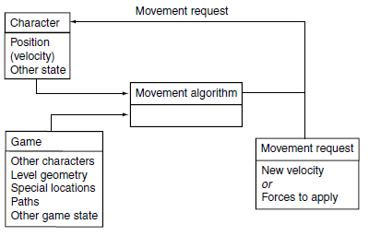
The Basics of Movement Algorithms
The Movement Algorithm Structure
Craig Reynolds also invented the flocking algorithm used in countless films and games to animate flocks of birds or herds of other animals

Slide 7
The Basics of Movement Algorithms
Two-Dimensional Movement
Although games rarely are drawn in two dimensions any more, their characters are usually under the influence of gravity, sticking them to the floor and constraining their movement to two dimensions.
Characters as Points
Although a character usually consists of a three-dimensional (3D) model that occupies some space in the game world, many movement algorithms assume that the character can be treated as a single point.
Collision detection, obstacle avoidance, and some other algorithms use the size of the character to influence their results, but movement itself assumes the character is at a single point.

Slide 8
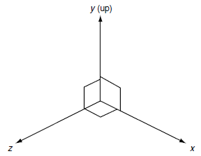
The Basics of Movement Algorithms
Statics
Characters in two dimensions have two linear coordinates representing the position of the object. These coordinates are relative to two world axes that lie perpendicular to the direction of gravity and perpendicular to each other. This set of reference axes is termed the orthonormal basis of the 2D space.
The 2D movement axes and the 3D basis

Slide 9
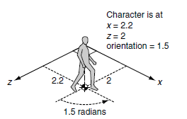
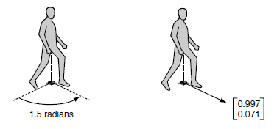
The Basics of Movement Algorithms
Statics
The positions of characters in the level
The vector form of orientation

Slide 10
The Basics of Movement Algorithms
Kinematics
So far each character has had two associated pieces of information: its position and its orientation.
We can create movement algorithms to calculate a target velocity based on position and orientation alone, allowing the output velocity to change instantly.
Characters need to keep track of both their linear and their angular velocities.
Linear velocity has both x and z components, the speed of the character in each of the axes in the orthonormal basis. If we are working in 2 ½ D, then there will be three linear velocity components, in x, y, and z.
The angular velocity represents how fast the character’s orientation is changing.

Slide 11
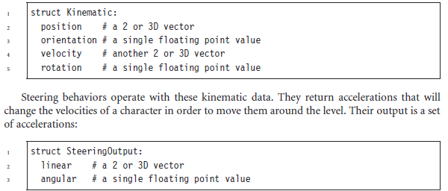
The Basics of Movement Algorithms
Kinematics
We will call angular velocity rotation, since rotation suggests motion. Linear velocity will normally be referred to as simply velocity. We can therefore represent all the kinematic data for a character (i.e., its movement and position) in one structure:

Slide 12

The Basics of Movement Algorithms
Independent Facing
Many steering behaviors ignore facing altogether. They operate directly on the linear components of the character’s data
This can be achieved by directly setting the orientation to the direction of motion, but this can mean the orientation changes abruptly.
A better solution is to move it a proportion of the way toward the desired direction: to smooth the motion over many frames
Smoothing facing direction of motion over multiple frames

Slide 13
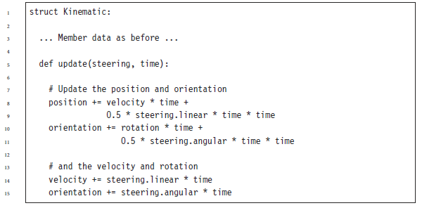
The Basics of Movement Algorithms
Updating Position and Orientation
If your game has a physics simulation layer, it will be used to update the position and orientation of characters.

Slide 14
The Basics of Movement Algorithms
Variable Frame Rates
Note that we have assumed that velocities are given in units per second rather than per frame.
Older games often used per-frame velocities, but that practice has largely died out.
Almost all games (even those on a console) are now written to support variable frame rates, so an explicit update time is used.
If the character is known to be moving at 1 meter per second and the last frame was of 20 milliseconds’ duration, then they will need to move 20 millimetres.

Slide 15
The Basics of Movement Algorithms
Forces and Actuation
To model this in a game, we could use the object’s mass for the linear inertia and the moment of inertia (or inertia tensor in three dimensions) for angular acceleration.
The movement controller considers the dynamics of the character in a post-processing step called actuation.
Actuation takes as input a desired change in velocity, the kind that would be directly applied in a kinematic system. The actuator then calculates the combination of forces that it can apply to get as near as possible to the desired velocity change.

Slide 16
Kinematic Movement Algorithms
Kinematic movement algorithms use static data (position and orientation, no velocities) and output a desired velocity.
The output is often simply an on or off and a target direction, moving at full speed or being stationary.
Kinematic algorithms do not use acceleration, although the abrupt changes in velocity might be smoothed over several frames.

Slide 17
Kinematic Movement Algorithms
SEEK
A kinematic seek behavior takes as input the character’s and its target’s static data.
It calculates the direction from the character to the target and requests a velocity along this line.
WANDERING
A kinematic wander behavior always moves in the direction of the character’s current orientation with maximum speed.
The steering behavior modifies the character’s orientation, which allows the character to meander as it moves forward.

Slide 18
Steering Behaviors
Steering behaviors extend the movement algorithms in the previous section by adding velocity and rotation.
They are gaining larger acceptance in PC and console game development.
In some genres (such as driving games) they are dominant; in other genres they are only just beginning to see serious use.
There is a whole range of different steering behaviors, often with confusing and conflicting names.
As the field has developed, no clear naming schemes have emerged to tell the difference between one atomic steering behavior and a compound behavior combining several of them together.

Slide 19
Steering Behaviors
Steering Basics
By and large, most steering behaviors have a similar structure. They take as input the kinematic of the character that is moving and a limited amount of target information.
The target information depends on the application.
For chasing or evading behaviors, the target is often another moving character.
Obstacle avoidance behaviors take a representation of the collision geometry of the world.
It is also possible to specify a path as the target for a path following behavior.
The set of inputs to a steering behavior isn’t always available in an AI-friendly format.

Slide 20
Steering Behaviors
Variable Matching
The simplest family of steering behaviors operates by variable matching: they try to match one or more of the elements of the character’s kinematic to a single target kinematic.
Variable matching behaviors take two kinematics as input:
the character kinematic
the target kinematic
The problem arises when more than one element of the kinematic is being matched at the same time.

Slide 21
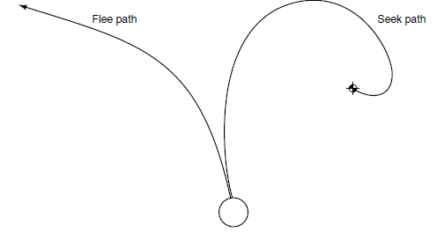
Steering Behaviors
Seek and Flee
Seek tries to match the position of the character with the position of the target. Exactly as for the kinematic seek algorithm, it finds the direction to the target and heads toward it as fast as possible.
Because the steering output is now an acceleration, it will accelerate as much as possible.

Slide 22
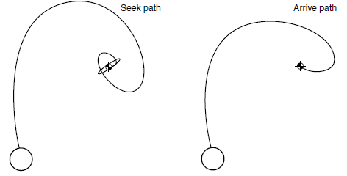
Steering Behaviors
Arrive
Seek will always move toward its goal with the greatest possible acceleration. This is fine if the target is constantly moving and the character needs to give chase at full speed. If the character arrives at the target, it will overshoot, reverse, and oscillate through the target, or it will more likely orbit around the target without getting closer.

Slide 23
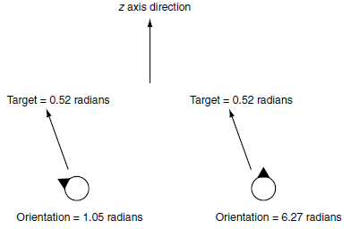
Steering Behaviors
Align
Align tries to match the orientation of the character with that of the target. It pays no attention to the position or velocity of the character or target. Recall that orientation is not directly related to direction of movement for a general kinematic. This steering behavior does not produce any linear acceleration; it only responds by turning.

Slide 24
Steering Behaviors
Velocity Matching
So far we have looked at behaviors that try to match position with a target.
We could do the same with velocity, but on its own this behavior is seldom useful.
It could be used to make a character mimic the motion of a target, but this isn’t very useful.
Where it does become critical is when combined with other behaviors. It is one of the constituents of the flocking steering behavior, for example.

Slide 25
Steering Behaviors
Delegated Behaviors
All the behaviors that follow have the same basic structure: they calculate a target, either position or orientation (they could use velocity, but none of those we’re going to cover does), and then they delegate to one of the other behaviors to calculate the steering.
The target calculation can be based on many inputs.
Pursue, for example, calculates a target for seek based on the motion of another target.
Collision avoidance creates a target for flee based on the proximity of an obstacle.
And wander creates its own target that meanders around as it moves.

Slide 26
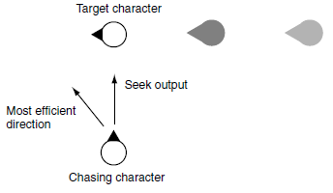
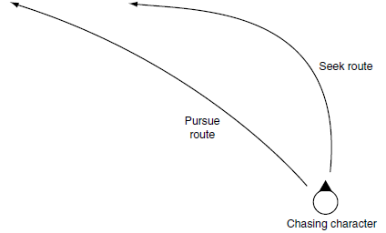
Steering Behaviors
Pursue and Evade
a seek behavior and a pursue behavior chasing the same target
Seek moving in the wrong direction
Seek and pursue

Slide 27
Steering Behaviors
Face
The face behavior makes a character look at its target.
It delegates to the align behavior to perform the rotation but calculates the target orientation first.
The target orientation is generated from the relative position of the target to the character.
Looking Where You’re Going
In many cases, however, we would like the character to face in the direction it is moving.
In the kinematic movement algorithms we set it directly. Using the align behavior, we can give the character angular acceleration to make it face the right way.
In this way the character changes facing gradually, which can look more natural, especially for aerial vehicles such as helicopters or hovercraft or for human characters that can move sideways (providing sidestep animations are available, of course).

Slide 28
Steering Behaviors
Wander
The wander behavior controls a character moving aimlessly about.
Path Following
Path following, as it is usually implemented, is a delegated behavior
Separation
The separation behavior is common in crowd simulations, where a number of characters are all heading in roughly the same direction
Collision Avoidance
A simple approach is to use a variation of the evade or separation behavior, which only engages if the target is within a cone in front of the character
Obstacle and Wall Avoidance
The collision avoidance behavior assumes that targets are spherical.

Slide 29
Predicting Physics:
Aiming and Shooting
Firearms, and their fantasy counterparts, are a key feature of game design. In almost any game you choose to think of, the characters can wield some variety of projectile weapon. In a fantasy game it might be a crossbow or fireball spell, and in a science fiction (sci-fi) game it could be a disrupter or phaser.
This puts two common requirements on the AI. Characters should be able to shoot accurately, and they should be able to respond to incoming fire. The second requirement is often omitted, since the projectiles from many firearms and sci-fi weapons move too fast for anyone to be able to react to.

Slide 30
Predicting Physics:
Aiming and Shooting
For fast-moving projectiles over small distances, this can be approximated by a straight line, so older games tended to use simple straight line tests for shooting.
With the introduction of increasingly complex physics simulation, however, shooting along a straight line to your targets is likely to result in your bullets landing in the dirt at their feet.
Predicting correct trajectories is now a core part of the AI in shooters.

Slide 31
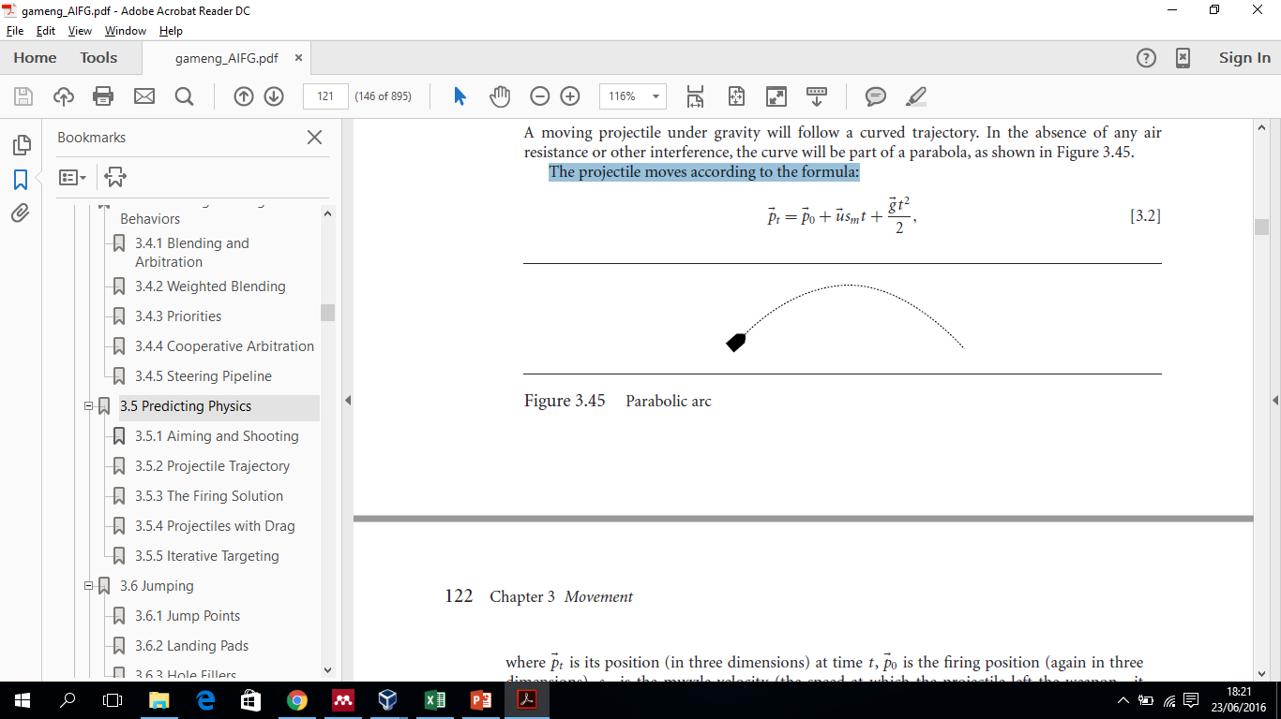
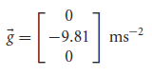
Predicting Physics:
Projectile Trajectory
A moving projectile under gravity will follow a curved trajectory. In the absence of any air resistance or other interference, the curve will be part of a parabola.
The projectile moves according to the formula:
It is worth noting that although the acceleration due to gravity on Earth is:

Slide 32
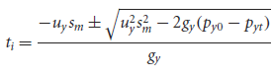
Predicting Physics:
Projectile Trajectory
Predicting a Landing Spot
The AI should determine where an incoming grenade will land and then move quickly away from that point (using a flee steering behavior, for example, or a more complex compound steering system that takes into account escape routes).
where p_{yi} is the position of impact, and t_{i} is the time at which this occurs.

Slide 33
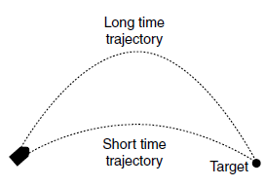
Predicting Physics:
The Firing Solution
In an indoor environment with many obstacles (such as barricades, joists, and columns), it might be advantageous for a character to throw its grenade more slowly so that it arches over obstacles.
Dealing with obstacles in this way gets to be very complex and is best solved by a trial and error process, trying different sm values (normally trials are limited to a few fixed values: “throw fast,” “throw slow,” and “drop,” for example).
Two possible firing solutions

Slide 34
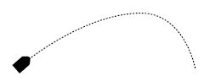
Predicting Physics:
Projectiles with Drag
The situation becomes more complex if we introduce air resistance. Because it adds complexity, it is very common to see developers ignoring drag altogether for calculating firing solutions.
Often, a drag-free implementation of ballistics is a perfectly acceptable approximation.
The trajectory of a projectile moving under the influence of drag is no longer a parabolic arc.
Projectile moving with drag

Slide 35
Predicting Physics:
Projectiles with Drag
Rotating and Lift
Another complication in the movement calculations occurs if the projectile is rotating while it is in flight.
We have treated all projectiles as if they are not rotating during their flight.
Spinning projectiles (golf balls, for example) have additional lift forces applying to them as a result of their spin and are more complex still to predict.

Slide 36
Predicting Physics:
Iterative Targeting
The process has two stages.
We initially make a guess as to the correct firing solution. The trajectory equations are then processed to check if the firing solution is accurate enough (i.e., does it hit the target?). If it is not accurate, then a new guess is made, based on the previous guess.
The process of testing involves checking how close the trajectory gets to the target location. In some cases we can find this mathematically from the equations of motion (although it is very likely that if we can find this, then we could also solve the equation of motion and find a firing solution without an iterative method).
In most cases the only way to find the closest approach point is to follow a projectile through its trajectory and record the point at which it made its closest approach.

Slide 37
References
Ian Millington. 2009. Artificial intelligence for games. Morgan Kaufmann Publishers. Burlington. ISBN:9780123747310
Game Movement, http://www.w3schools.com/graphics/game_movement.asp

